Slide 1
Bangalore Analysis
A Data Science Capstone Project by- Sahil Sinha

Slide 2
INTRODUCTION
Bangalore is IT hub of India and is also referred to as a Silicon Valley of India.
Due to its rapid growth it has great potential to attract businesses.
By a proper data analysis of the city could provide with important answers like
What kind of businesses have scope in Bangalore?
Which location is best suited for the business to get maximum profit?

Slide 3
Data Acquisition & Cleaning
To gather localities in Bangalore web scraping was done from a well reputed news channel’s site – link.
Coordinates of the localities were added in separate column.
Duplicate and Null values were removed.
Unnecessary columns ‘Taluk’ and ‘State’ were removed.
Areas within 35kms of Bangalore center was kept to get rid of outliers.

Slide 4
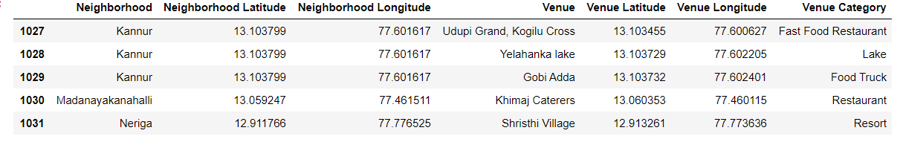
Adding Venues to each Neighborhood using FourSquare API
Results returned from using FourSquare API on the localities

Slide 5
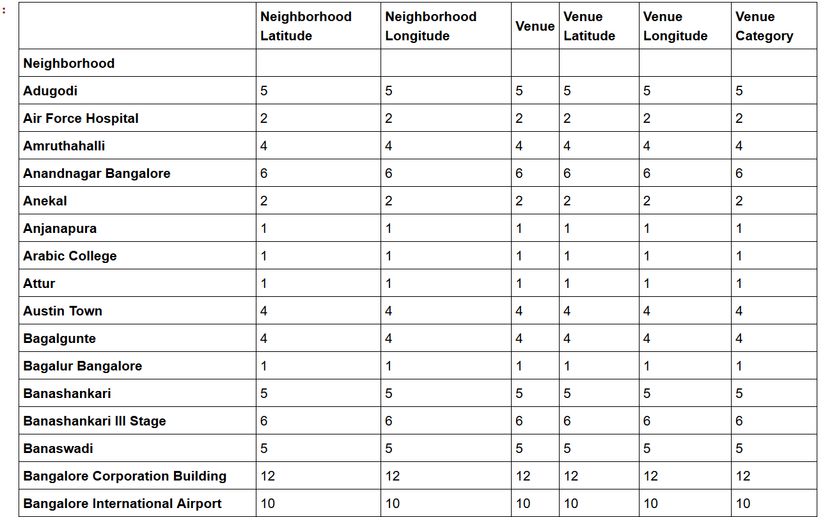
DATA ANALYSIS
Finding the total count of venues that each locality had

Slide 6
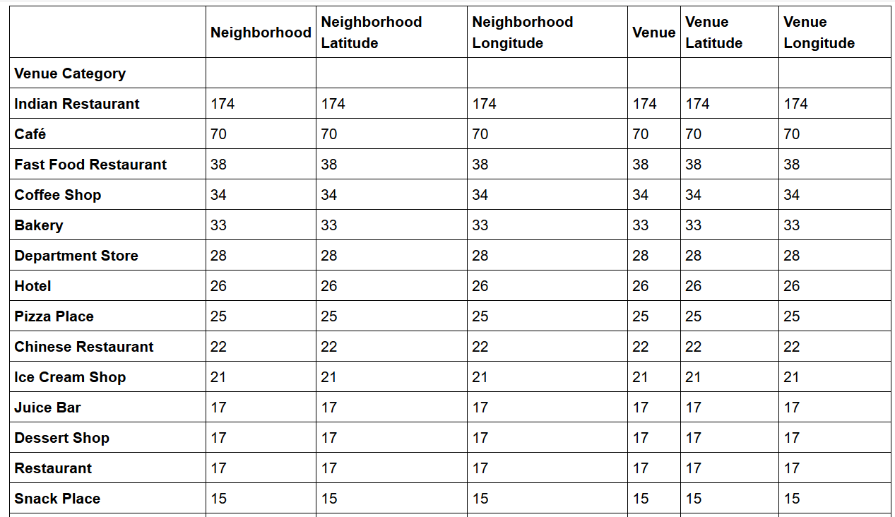
Finding total no. of different venues present in Bangalore
A sample of results from the total no. of different venues present in Bangalore

Slide 7
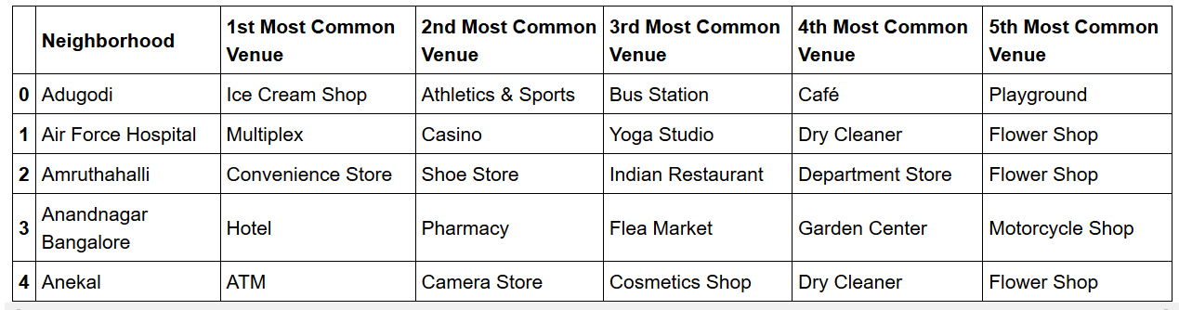
Finding top 5 most common venues in each locality
Sample of neighborhoods with their most common venues

Slide 8
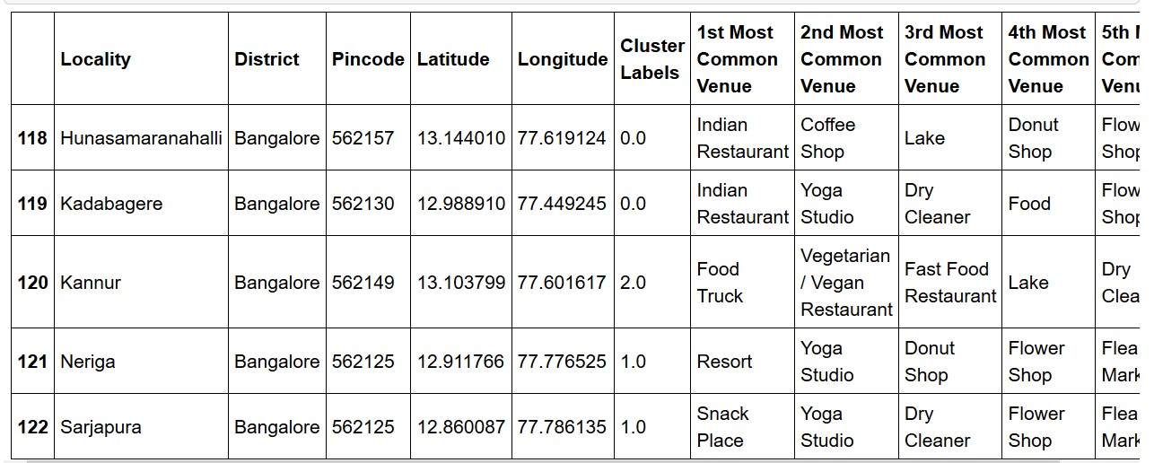
Methodology (Clustering k-means)
Taking K-value as 5 and applying K-means Clustering algo.
Adding Cluster Label column to store cluster nos.
Sample of Locality with their cluster labels

Slide 9
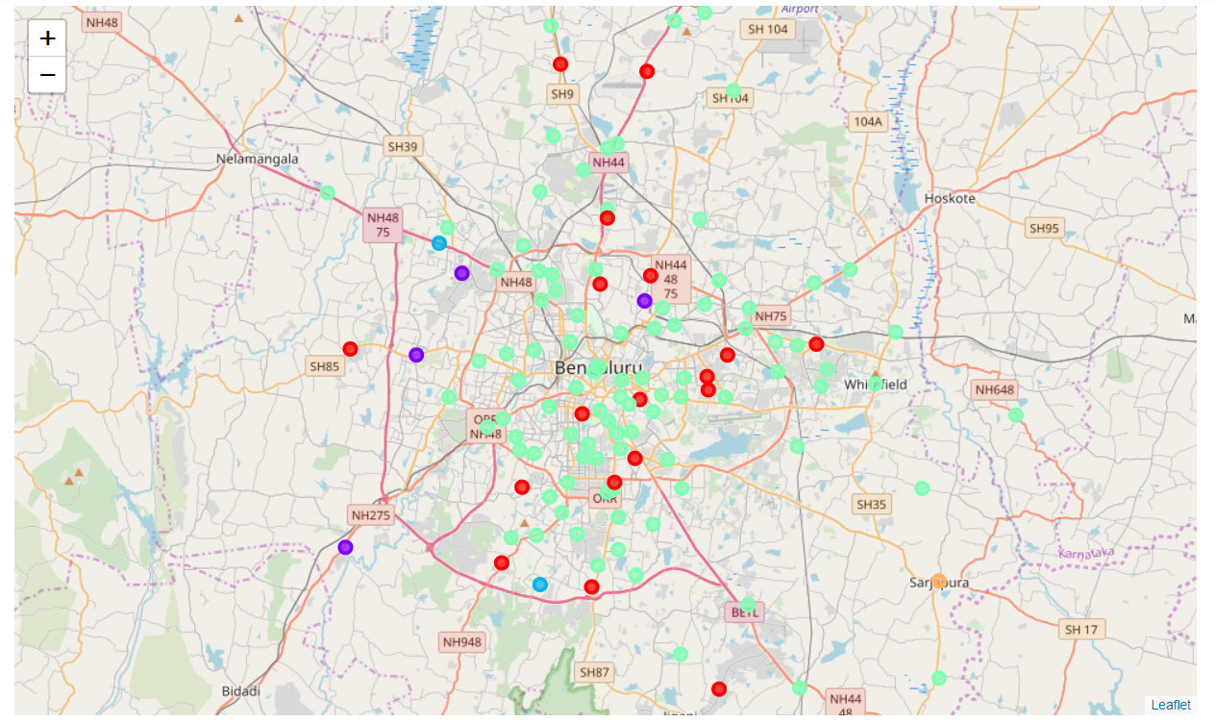
Results and Discussion
Following distribution of localities was obtained in different clusters using folium package

Slide 10
The first cluster is a hub of Indian Restaurants, most of them having some yoga centers and some flower shops.
The second cluster has variety of things and places with non-traditional Indian restaurants and many fitness places.
The third cluster are places having chain of Fast food Restaurants and multiple entertainment places like multiplex, casino, sports bar etc.
The fourth cluster are food hubs of the city with enough restaurants and cafes present.
The fifth cluster are the locations with majority of ATMs of city and many flea shops.

Slide 11
RECOMMENDATIONS
The following recommendations could be provided according to the results:
First Cluster- Non Indian restaurants or fast food restaurants can be opened there.
Second Cluster- It could be mixed with some traditional Indian Restaurants.
Fifth Cluster- It has a lot of ATMs so it could be used as a reference before installing new ATMs.

Slide 12
CONCLUSION
It included all the localities of Bangalore.
To protect my analysis from all the outliers I kept only the urban areas by keeping the localities which were within 35kms from the center.
All the venues were extracted near every locality using FourSquare API.
At last, neighborhoods were clustered together using K-Means Clustering.

Slide 13
THANK YOU!!!!!

